Slide 1


Slide 2
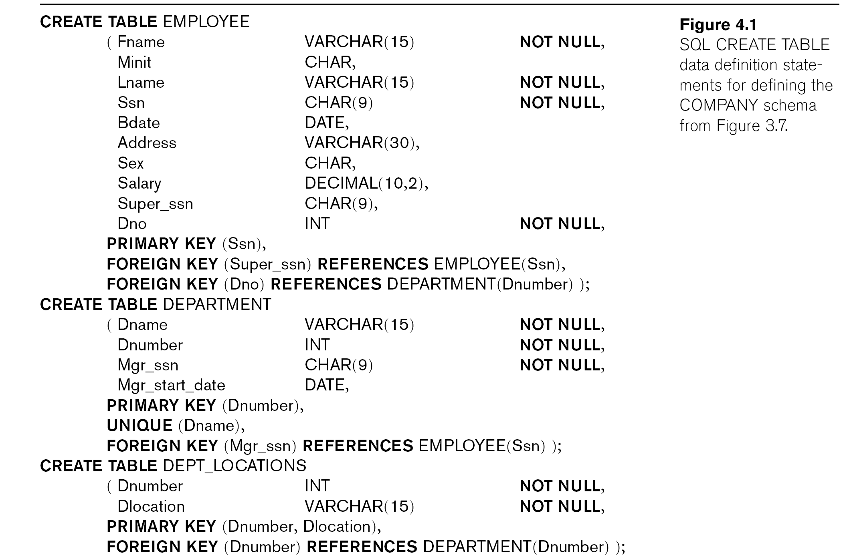
Continued next page…

Slide 3
